Slide 1
DSO510 Project 2
Cheng CHEN, Cheng ZHANG, Jie CHEN,
Mi ZHONG, Xinyu LIANG, Yang LU, Yinghan LIU

Slide 2
Goal Definition
Analyze the relationship between gross box office of a movie and other independent variables including genre, budget, popularity of director and cast, etc., in order to:
guide film producers/investors on how to make high-quality movies, and
help movie theaters predict which movies will generate higher box office

Slide 3
Data Collection
Source 1: IMDB 5000 Movie Dataset from Kaggle
The original dataset contains 28 variables for 5,043 movies
Only movies produced after 2000 are included; we replaced part of the missing data with median value of corresponding variables
A total number of 3,170 observations are used in analysis
Source 2: Scraped data from IMDB
Month of release → Summer/Christmas/Other
Source 3: Calculated variables
Gross Box Office / Budget
Actor1 FB Likes / Cast Total FB Likes

Slide 4
Variables
Variables | Type | Explanation
Gross (dependent variable) | Numeric | Cumulative box office in United States
IMDB Score (dependent variable) | Numeric | IMDB rating score of the movie
Duration | Numeric | Length of the movie
Genre | Categorical | Genre of the movie (Action/Sci-Fi/Romance/...)
Country | Categorical | Country that produced the movie
Budget | Numeric | Budget of the movie (in USD)
Content Rating | Categorical | Content rating of the movie (G/PG/PG-13/R/…)
Director Facebook Likes | Numeric | Facebook popularity of the director
Cast Total Facebook Likes | Numeric | Facebook popularity of all cast members
Number of Critics for Reviews | Numeric | Number of critics that reviewed the movie

Slide 5
Variables
Gross Box Office | Duration Country MPAA Rating Director FB Likes Cast Total Facebook Likes Genre | Budget Num critics for reviews IMDB Score Summer/Christmas Release (Day, Month, Year) Gross/Budget Actor1/Cast Total FB Likes
IMDB | Duration Country MPAA Rating Director FB Likes Cast Total Facebook Likes Genre | Budget Num critics for reviews Total FB Likes of Actor 1, 2, 3 Gross/Budget

Slide 6
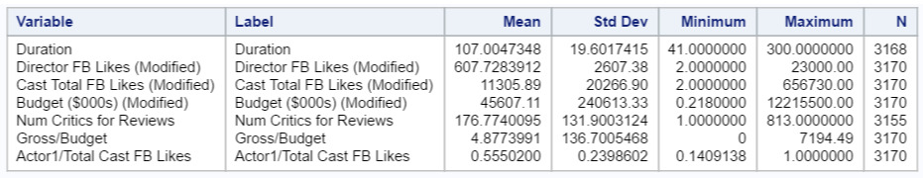
Descriptive Statistics: Dependent variables
Descriptive Statistics: independent numeric variables

Slide 7
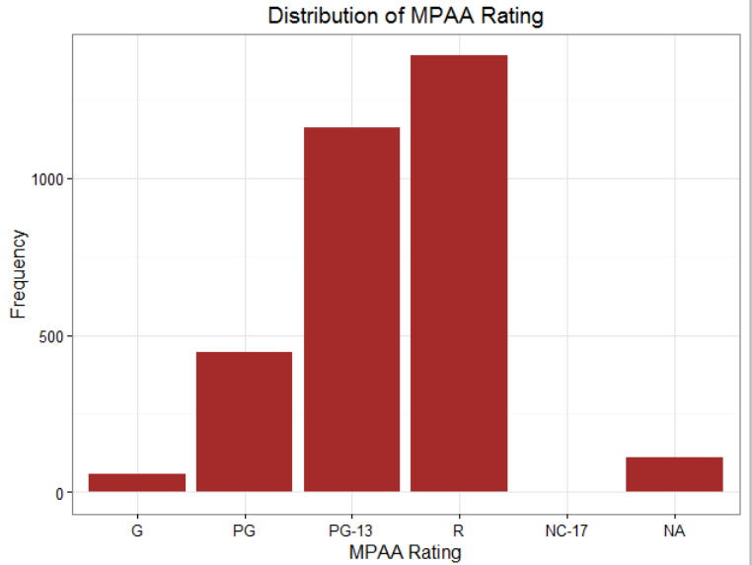
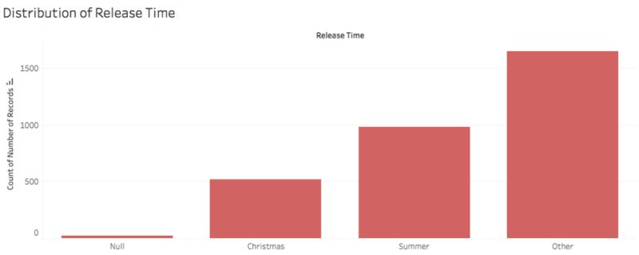
Descriptive Statistics: independent categorical variables

Slide 8
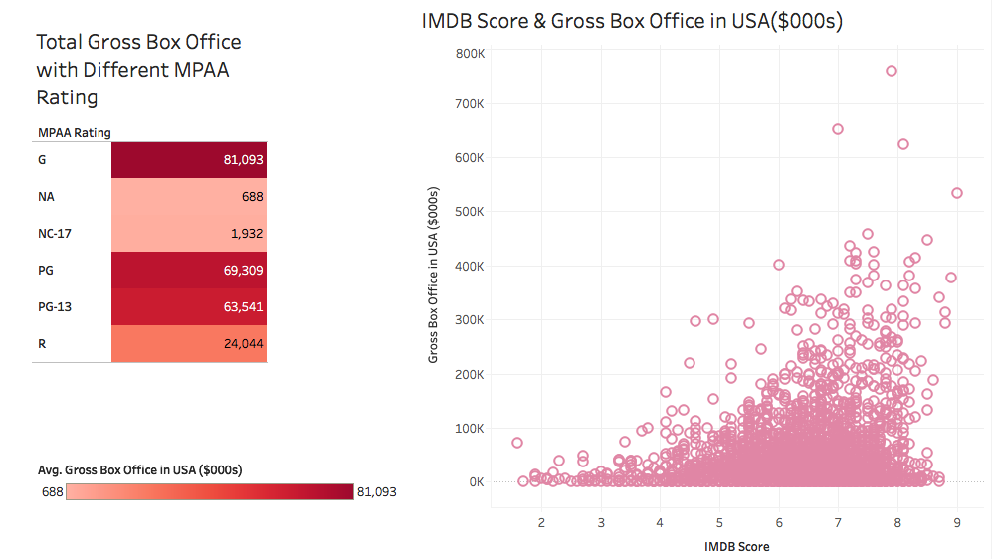
Gross box office & independent variables

Slide 9
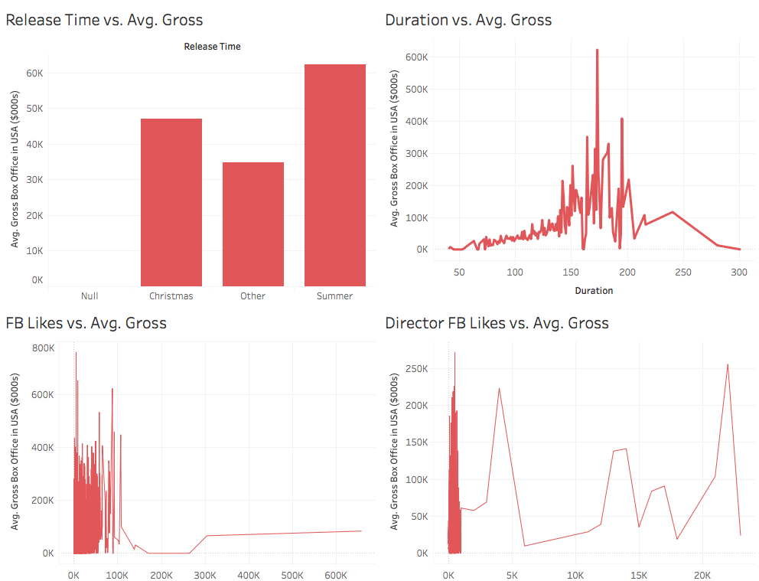
Gross box office & independent variables

Slide 10
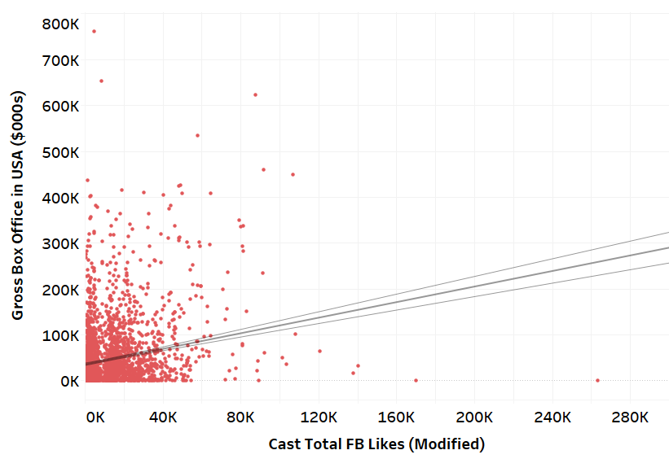
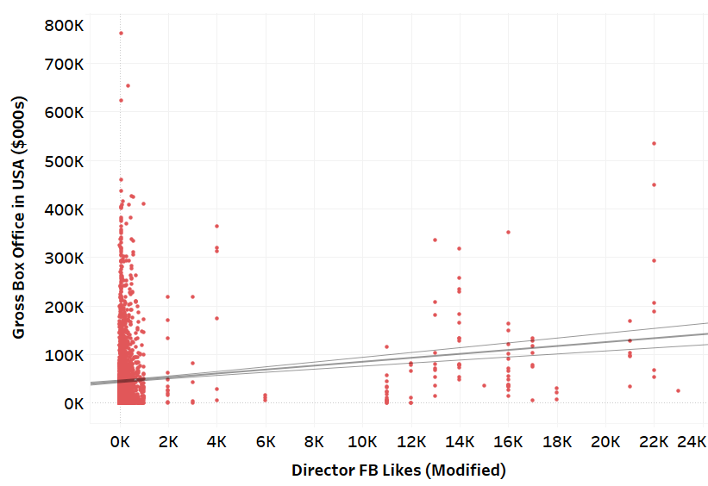
Gross box office & independent variables

Slide 11
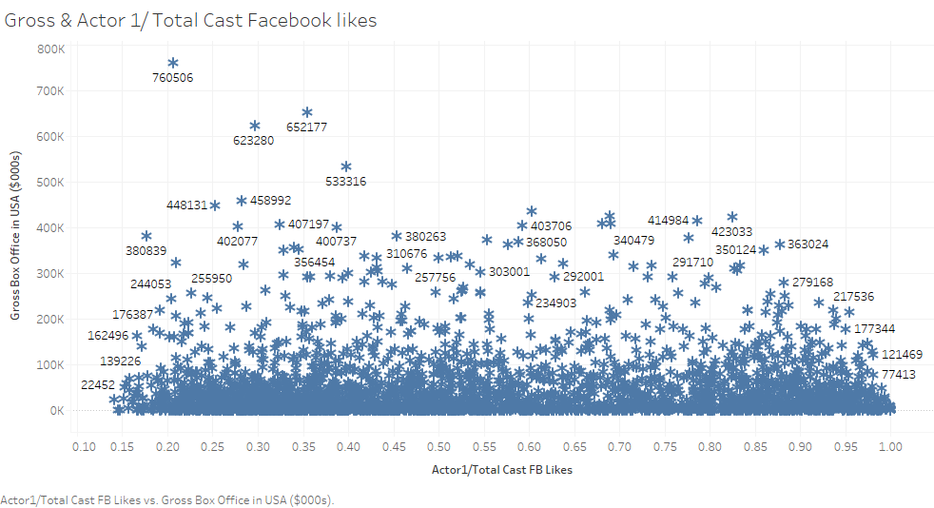
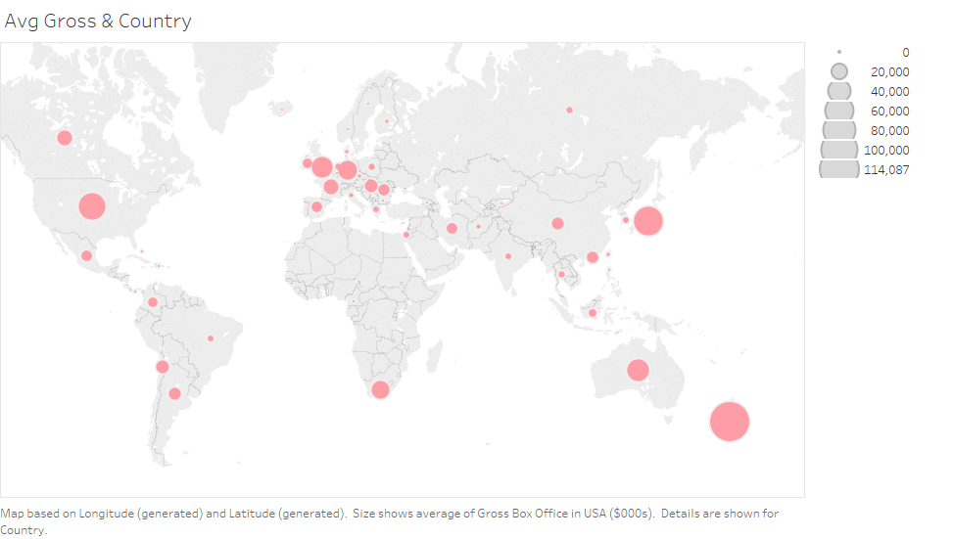
Gross box office & independent variables
Gross & Actor 1/Total Cast FB Likes
Avg. Gross & Country

Slide 12
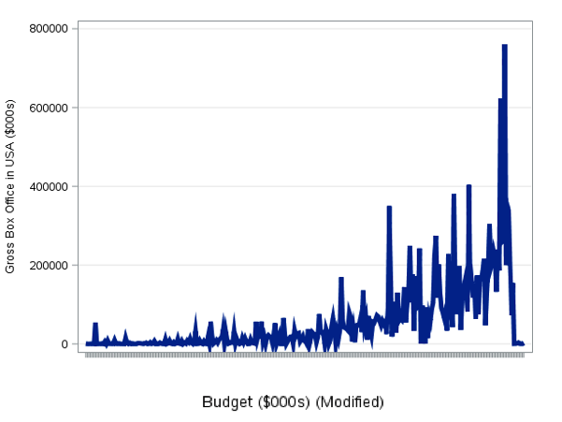
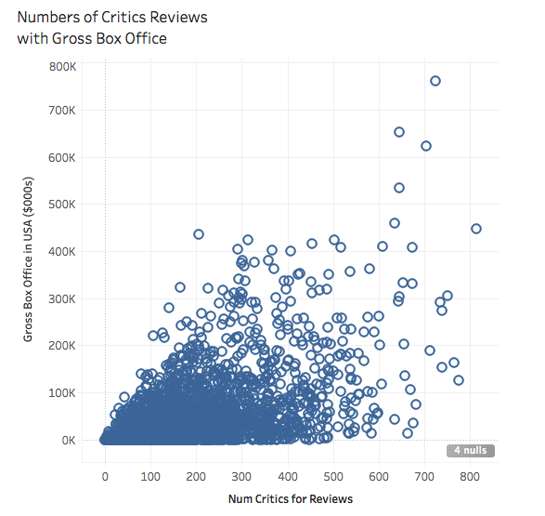
Gross box office & independent variables

Slide 13
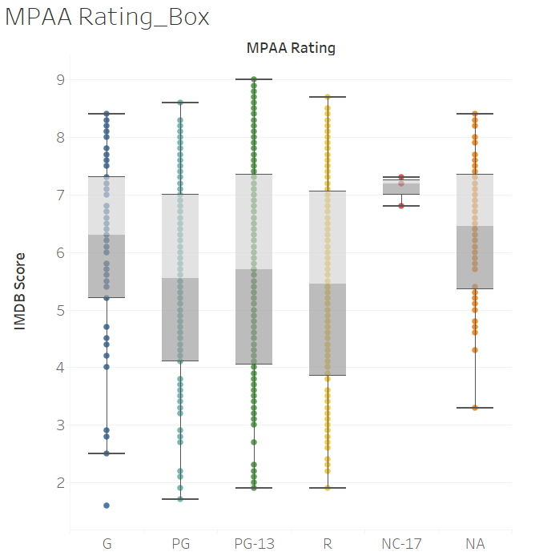
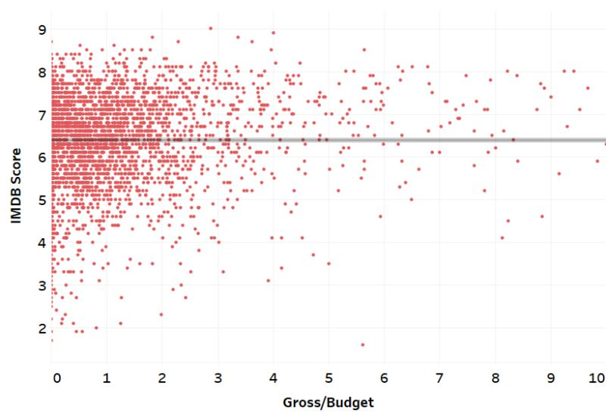
IMDB Scores & independent variables

Slide 14
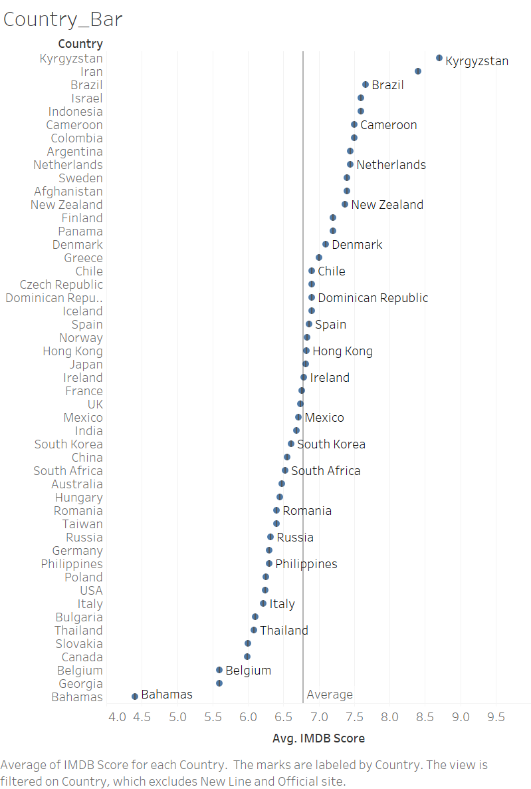
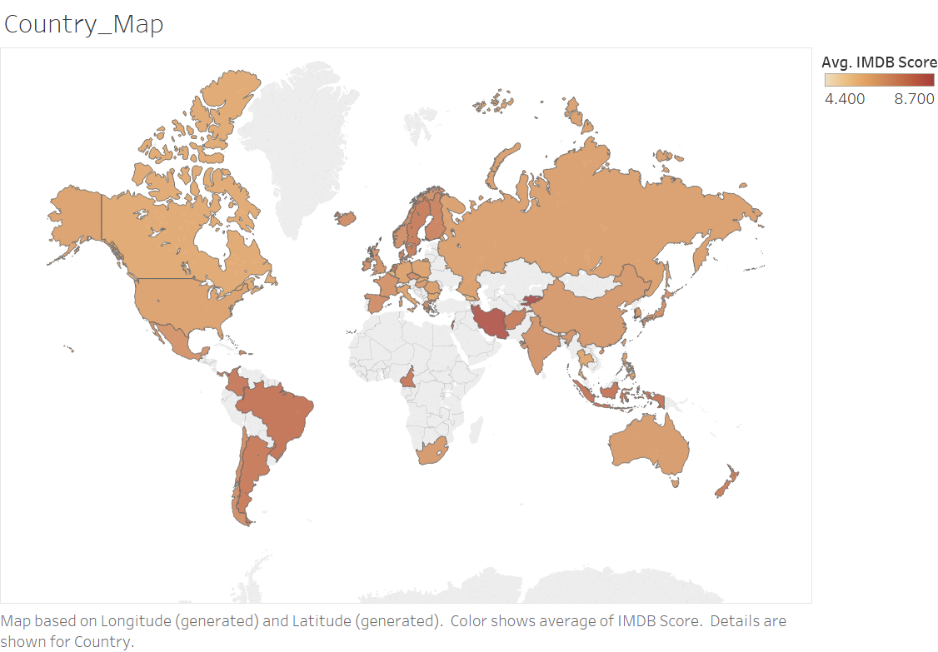
IMDB Scores & independent variables

Slide 15
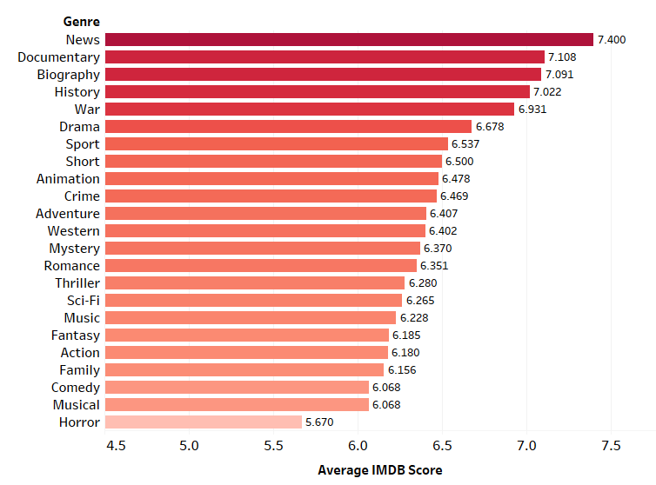
IMDB Scores & independent variables
Genre | IMDB Score | Number of Movie
News | 7.400 | 1
Documentary | 7.108 | 85
Biography | 7.091 | 204
History | 7.022 | 127
War | 6.931 | 124
Drama | 6.678 | 1609
Sport | 6.537 | 131
Short | 6.500 | 1
Animation | 6.478 | 185
Crime | 6.469 | 553
Adventure | 6.407 | 589
Western | 6.402 | 42
Mystery | 6.370 | 335
Romance | 6.351 | 697
Thriller | 6.280 | 904
Sci-Fi | 6.265 | 358
Music | 6.228 | 139
Fantasy | 6.185 | 386
Action | 6.180 | 735
Family | 6.156 | 382
Comedy | 6.068 | 1210
Musical | 6.068 | 65
Horror | 5.670 | 336

Slide 16
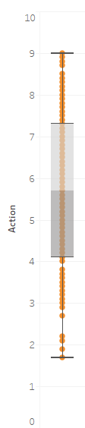
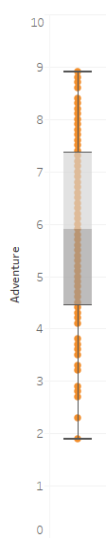
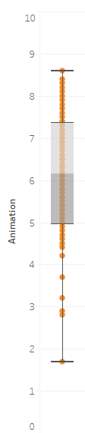
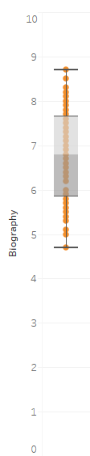
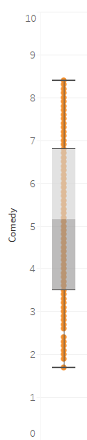
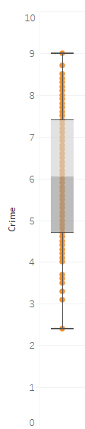
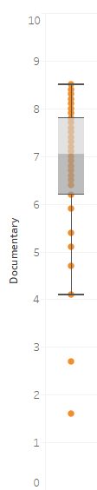
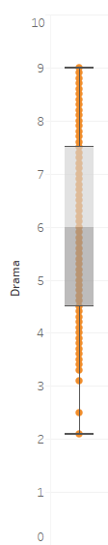
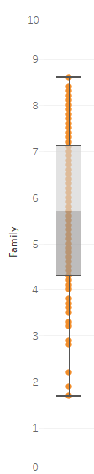
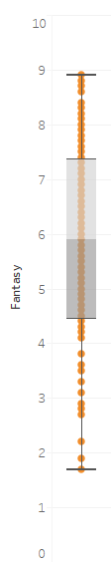
IMDB Scores & independent variables
Distribution of IMDB Score Based on Genre
Action Adventure Animation Biography Comedy Crime Documentary Drama Family Fantasy

Slide 17
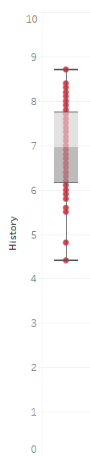
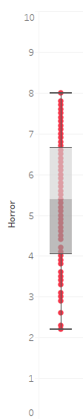
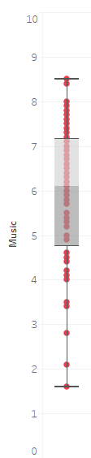
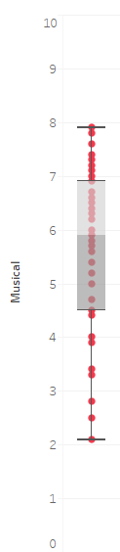
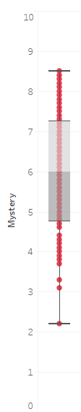
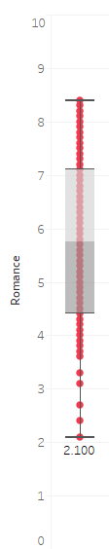
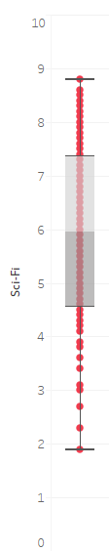
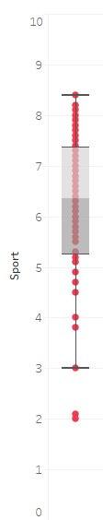
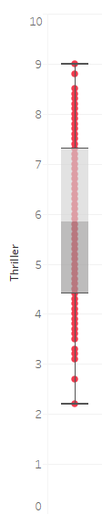
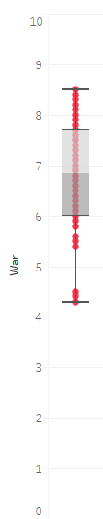
IMDB Scores & independent variables
Distribution of IMDB Score Based on Genre
History Horror Music Musical Mystery Romance Sci-Fi Sport Thriller War

Slide 18
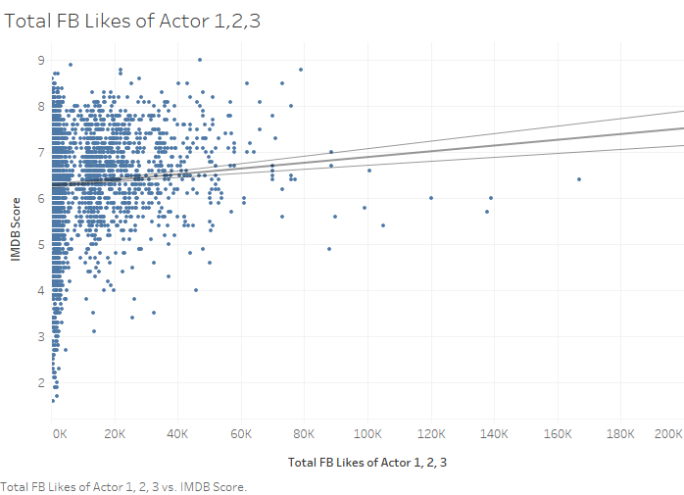
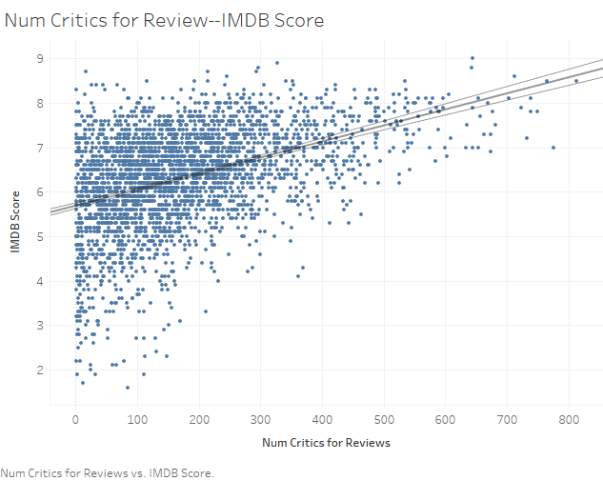
IMDB Scores & independent variables

Slide 19
Interpretation, Action, and Feedback
Describe interpretation of the data analysis and modeling in the context of the business goal
Use Excel, SAS, Tableau to dig further into the relationship between gross box office/IMDB score and all the selected independent variables
Find the most relevant variables for producers/investors to make quality/revenue-related decisions
Analyze the best combinations of directors, film genres, actors, budget, etc. for producers to proceed a best-selling movie
Notes:
relationship (positive/ negative correlation, trend, etc.)

Slide 20
Interpretation, Action, and Feedback
Possible options and/or decisions available to the business based on the data analysis and modeling
For film producers/movie theaters, in order to produce/select a movie having high box office potential, it is recommended that they:
choose director and actors with higher Facebook likes/search interest
make movies in...genre/with...duration/etc. that attracts more audiences
consider the marginal effect of …(independent variable) on box office

